Slide 1
about:openSUSE
Note for presenter:
check the 'notes' for each slide, they contain notes and info
and remove this text box!
Your name
OpenSUSE ambassador
XXX@opensuse.org
Notes:
Hi! This is a one-minute introduction to openSUSE and it's many great technologies!
I am XXXXX and welcome you.

Slide 2
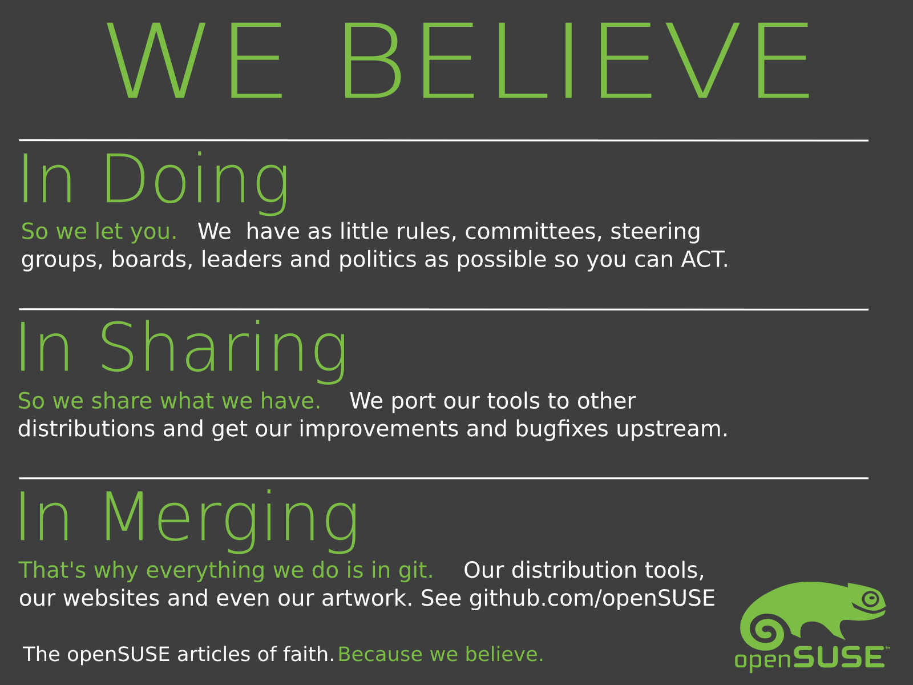
Notes:
To get to know openSUSE, you have to start with the people behind it.
We're an international crowd, and we believe that Free and Open is better than Closed. We believe that you get the most out of people by getting out of their way, by letting them share what they do and work with others across project and cultural boundaries!

Slide 3
the world's most flexible and powerful Linux distribution
Notes:
These people create a powerful and flexible Linux. We want to create something ready for real usage: easy but not limited, stable but not outdated. That's why we have a longer release cycle than most other distributions and have the best system management tools in the industry.

Slide 4




CHOICE
is
GOOD
Notes:
So while we try to keep things as easy as possible, we don't compromise flexibility and choise.
We ship all the latest desktops and openSUSE features. YaST, a graphical tool which offers unique functionality like setting up VM's and webservers, configuring networked printers and advanced security tools.

Slide 5
Tumbling
More
and
Than just
Rolling
A DISTRO
.
.
.
Notes:
openSUSE is more than a distribution – it is a project.
We introduced Tumbleweed, a rolling release on openSUSE.
Packman is a openSUSE related project providing lots of extra multimedia packages.

Slide 6

OBS...
Free
on
build.opensuse.org
200.000
users
packages
40.000
26
7
distributions
OpenSUSE ARMs
architectures
Notes:
The Open Build Service is a tool to build packages for ANY linux distribution (or even Windows if you want). It uses a Virtual Machine to cleanly build, has dependency tracking, team collaboration features and is completely useable through an easy to use Web Interface.
If you want to build packages for Fedora, Ubuntu, Mandriva, openSUSE and more – check it out on build.o.o
Of course it is Free Software and you can run your own instance, like Tizen/MeeGo/Mer, VLC, Dell and many others do.

Slide 7

openQA
Fully automated testing
  Used to daily test openSUSE Factory
Easy web interface showing results as images and video
Free and cross-platform Software
  Run your own tests on your own system!
  openqa.opensuse.org
Notes:
openQA is a automated testing system which runs daily tests on the openSUSE development tree 'Factory'.
It boots an OS image in a VM, installs the OS, tests some apps and screenshots that whole process. Then it compares the screenshots to reference shots and reports the results.
Of course it is Free Software and can test ANY OS. MS DOS, even, if you want. We maintain it for Fedora, Debian, openBSD and some more.

Slide 8

Newcomers welcome
Notes:
openSUSE is always looking for new volunteers
people who actually want to make a difference!
We're an OPEN project, we have no 'steering committees' or 'benevolent dictators'. In openSUSE, you do as you please.

Slide 9
Notes:
openSUSE is easy to find: try opensuse.org or our many other communication channels. It's all free and open!

Slide 10

Join the gang
Notes:
... come join us and have fun...
Try openSUSE, SUSE Studio, TRY OBS, play with us!

Slide 11
Kitty Image credits
Newcomers: abcrumly
Join the gang: malingering
To be found on Flickr under the above names with a Creative Commons license. Thanks all!

